Slide 1


Mobile Phone Security
Dr. Digvijaysinh Rathod
Associate Dean
School of Cyber Security and Digital Forensics
National Forensic Sciences University
digvijay.rathod@nfsu.ac.in

Slide 2
Android Sanboxing
Secure inter-process communication
Dr. Digvijaysinh Rathod

Slide 3

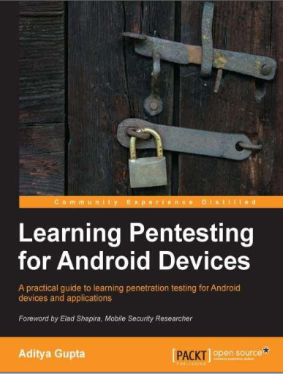
Reference
digvijay.rathod@gfsu.edu.in

Slide 4
Application sandboxing
In order to isolate applications from each other
Android takes advantage of the Linux user-based protection model.
In Linux systems, each user is assigned a unique user ID (UID) and users are segregated so that one user does not access the data of another user.
All resources under a particular user are run with the same privileges.
Dr. Digvijaysinh Rathod

Slide 5
Application sandboxing
Android application is assigned a UID and is run as a separate process.
What this means is that even if an installed application tries to do something malicious, it can do it only within its context and with the permissions it has.
By default, applications cannot read or access the data of other applications and have limited access to the operating system.
Dr. Digvijaysinh Rathod

Slide 6
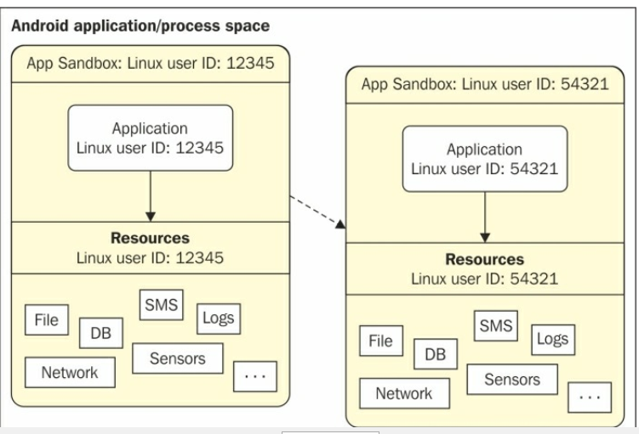
Application sandboxing
Two applications on different processes on with different UID's
Dr. Digvijaysinh Rathod

Slide 7
What is Android Broadcast Receiver?
Since the application sandbox mechanism is implemented at the kernel level, it applies to both native applications and OS applications.
Dr. Digvijaysinh Rathod

Slide 8
Secure inter-process communication
As discussed in the above sections, sandboxing of the apps is achieved by running apps in different processes with different Linux identities.
System services run in separate processes and have more privileges.
Thus, in order to organize data and signals between these processes, an inter-process communication (IPC) framework is needed.
In Android, this is achieved with the use of the Binder
Dr. Digvijaysinh Rathod

Slide 9
Secure interprocess communication
The Binder framework in Android provides the capabilities required to organize all types of communication between various processes.
Android application components, such as intents and content providers, are also built on top of this Binder framework.
Using this framework, it is possible to perform a variety of actions such as invoking methods on remote objects.
Dr. Digvijaysinh Rathod

Slide 10
Secure interprocess communication
Let us suppose the application in Process 'A' wants to use certain behavior exposed by a service which runs in Process 'B’.
In this case, Process 'A' is the client and Process 'B' is the service.
The communication model using Binder is shown in the following diagram:
Dr. Digvijaysinh Rathod

Slide 11
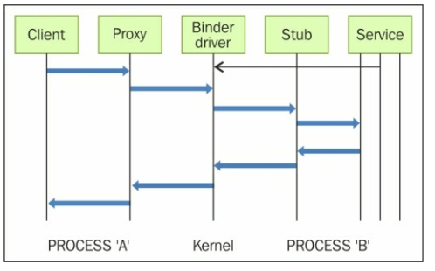
Secure interprocess communication
Binder Communication Model
Dr. Digvijaysinh Rathod

Slide 12
Secure interprocess communication
All communication between the processes using the Binder framework occurs through the /dev/binder Linux kernel driver.
The permissions to this device driver are set to world readable and writable.
Hence, any application may write to and read from this device driver.
All communications between the client and server happen through proxies on the client side and stubs on the server side.
Dr. Digvijaysinh Rathod

Slide 13
Secure interprocess communication
To get this process working, each service must be registered with the context manager.
the context manager acts as a name service, providing the handle of a service using the name of this service.
Thus, a client needs to know only the name of a service to communicate.
Each service (also called a Binder service) exposed using the Binder mechanism is assigned with a token.
Dr. Digvijaysinh Rathod

Slide 14
Secure interprocess communication
This token is a 32-bit value and is unique across all processes in the system.
A client can start interacting with the service after discovering this value.
This is possible with the help of Binder’s context manager.
the context manager acts as a name service, providing the handle of a service using the name of this service
Dr. Digvijaysinh Rathod

Slide 15
Secure interprocess communication
The name is resolved by the context manager and the client receives the token that is later used for communicating with the service.
Dr. Digvijaysinh Rathod

Slide 16
Mobile Phone Security
Dr. Digvijaysinh Rathod
Associate Professor
(Cyber Security and Digital Forensics)
Institute of Forensic Science
Gujarat Forensic Sciences University
digvijay.rathod@gfsu.edu.in

